Slide 1

COMP7500/7506 Advanced Operating Systems
Project 2
A Pipe-based WordCount Tool:
Optional Requirements
Dr. Xiao Qin
Auburn University http://www.eng.auburn.edu/~xqin
xqin@auburn.edu
Notes:
Project 2: Design
Data Flow Diagram
Function Prototypes
50 Minutes: Slides 1-15

Slide 2
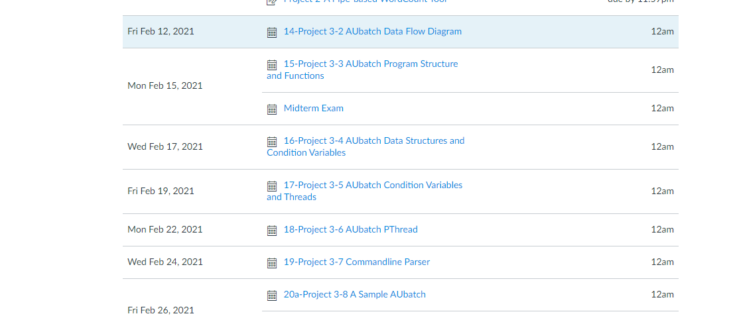

Slide 3

Optional Requirements
Mandatory Requirements: (Beginner)
Programming Skill:
Programming Skill:
Option 1: (Normal)
Separate Compilation
Option 2: (Hard)
Handle Large Files
Option 3 (Nightmare):
Configuration
Option 4 (Impossible):
Performance Evaluation
Notes:
Option 1: 1-star programmer
Options 2-4: 3-star programmer
Five difficulty levels:
1 Beginner
2 Normal
3 Hard
4 Suicidal
5 Hell on Earth

Slide 4
Option 4:
Performance Evaluation
Difficulty Level:
Impossible

Slide 5
Separate Compilation (Optional Requirement 1)
Who?
What?
To learn separate compilation using make
How?
To follow the instructions in Section 5
You are unfamiliar with separate compilation
Difficulty Level
Normal
Notes:
Primitives are defined as:
send(A, message) – send a message to mailbox A
receive(A, message) – receive a message from mailbox A

Slide 6
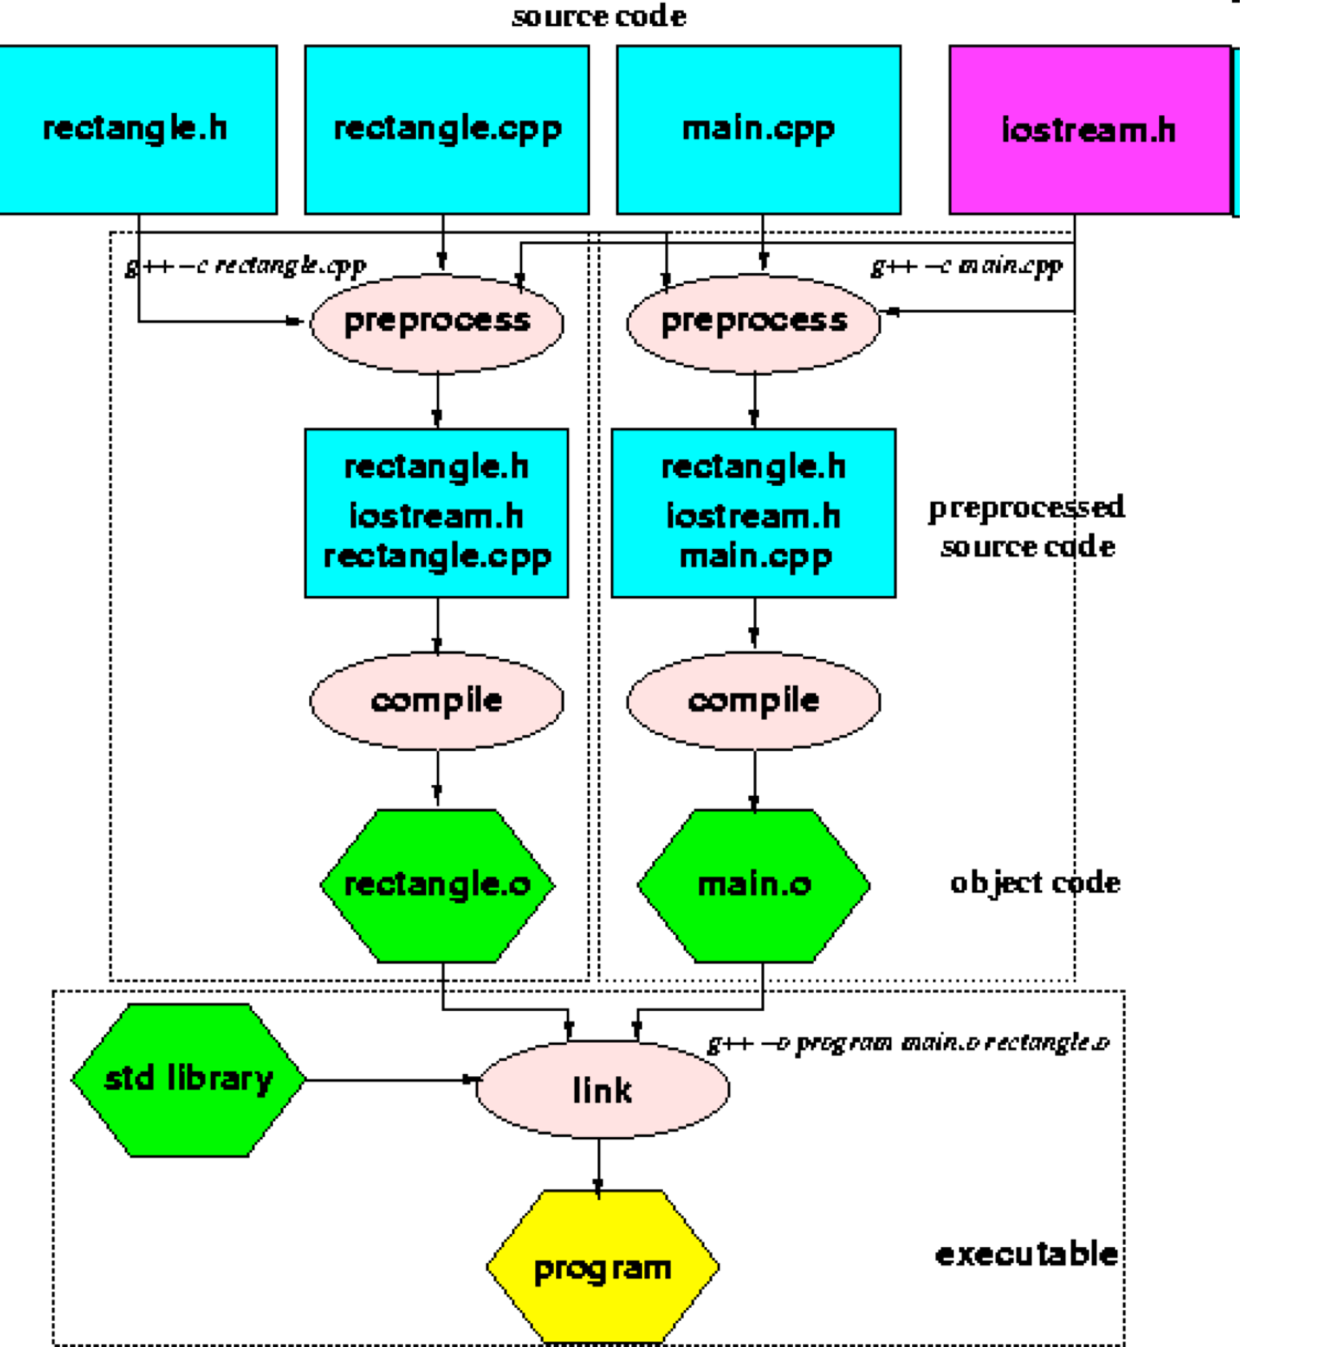
Separate Compilation
Difficulty Level
Normal
Notes:
Linux Kernel Grows Past 15 Million Lines of Code.
Makefiles provide a way for separate compilation. When a file from a project is changed, only the files that depend on the changed file are compiled.

Slide 7
An Example
dtime.h dtime.c timedemo.c
gcc -c dtime.c
gcc -c timedemo.c
gcc dtime.o timedemo.o –o timedemo
Makefile
The make Utility Program

Slide 8
Large Input Files (Optional Requirement 2)
Who?
What?
To handle a special case: Input files are larger than the buffer size in pWordCount
How?
To implement a multiple transfer mechanism
You are good at C programming on Linux
To implement a communication protocol
Difficulty Level
Hard
Notes:
Advanced Features

Slide 9
Configuration (Optional Requirement 3)
Who?
What?
To offer a configuration feature: enable configuring buffer size and more.
How?
To implement a configuration mechanism
You are good at C programming on Linux. You enjoy programming
To store configuration data in a file
Difficulty Level
Nightmare
Notes:
Advanced Features

Slide 10
Performance Evaluation (Optional Requirement 4)
Who?
What?
To evaluate and tune performance
How?
To investigate impacts of file size and buffer size on response time. Automation?
You are good at C programming on Linux. You enjoy programming and research
Difficulty Level
Impossible
Notes:
Advanced Features

Slide 11
Exercise 1 (Plickers): Which difficulty level (i.e., option) in Project 1 will you choose?
Beginner
Normal: Separate Compilation
Hard: Handle Large Files
Nightmare or above: Configuration, Performance Evaluation

